Slide 1
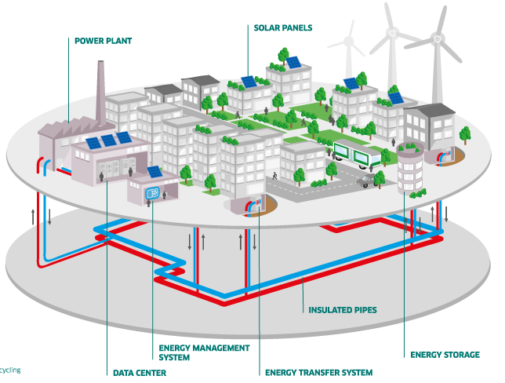
Energy Hub (E-Hub) Modeling Tool v2.0 Introduction & Demonstration
Mashael Yazdanie
March 21, 2018

Slide 2
Goals
Introduction of the E-Hub Tool
What is it?
Why use it?
Scope and input parameters
Limitations
Demonstration
Getting started with the E-Hub Tool
Configure input file, run model, view results
Cases illustrating breadth of applications
Future development / your inputs

Slide 3
What is the E-hub Modeling Tool?
An open source, bottom-up, energy system modeling and MILP optimization tool, suitable for representing a broad range of energy systems
Facilitates energy system capacity and dispatch (operation) planning
Provides users with the flexibility to define an energy hub as an interconnected system of self-described:
energy carriers;
energy conversion and distribution technologies (i.e., converters, storages, and network links); and
energy demands
Single or multi-hub optimization

Slide 4

Benefits of the E-hub Tool Approach
Easy to use:
Intended to be easy to setup, learn and use for both experienced and novice energy system modelers
Suitable for both “quick and dirty” modeling or more in-depth analyses
Fast model setup through spreadsheet interface
Intuitive and flexible navigation of results through (optional) spreadsheet interface
Flexible modeling framework:
Energy systems can be defined to capture a wide range of scales and scopes (e.g., building level, neighborhoods, cities, cantons, etc.)
A wide range of energy conversion, distribution and storage technologies can be defined by users
Experienced users may define custom modules using Python/Pyomo
Results are saved in a text file format which can be further processed

Slide 5
Benefits of the E-hub Tool Approach
Ease of development:
Python-based, open-source code
Transparent documentation and code
Open collaboration and development opportunities (vs. commercial software packages)

Slide 6
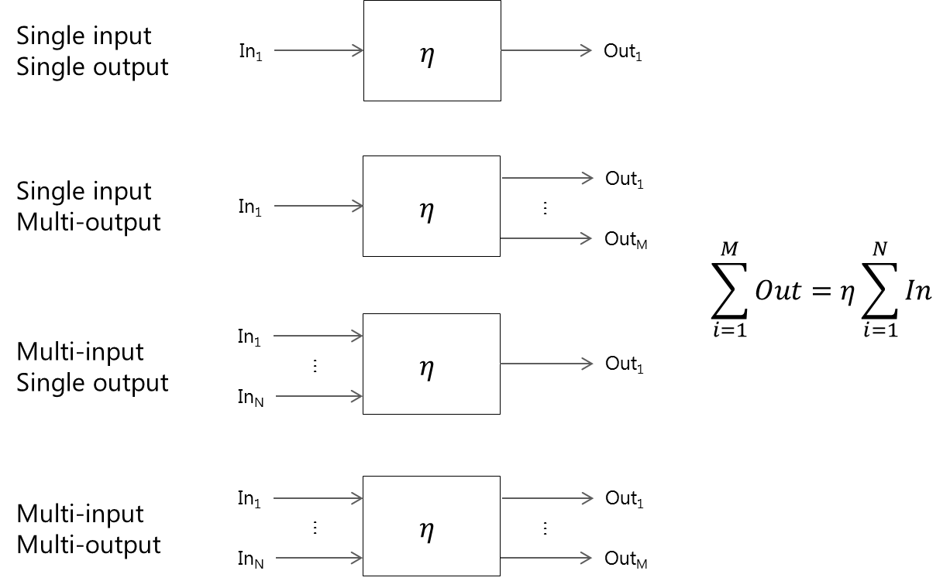
Modeling Scope & Input Parameters Overview
Minimize cost or carbon emissions
Time scale: hourly
Specify any multi/single input/output energy conversion process which can be defined in terms of energy carrier streams and efficiencies
…optionally, specify:
fixed input and/or output shares
part-load efficiency
pre-existing capacities
caps on operation and capacity
hourly solar insolation profile for solar technologies
Energy carrier tracking
Optional constraints on total carbon emissions and import supplies
Carbon emissions specifiable for energy carriers and tech installations
Capacity factors (annual and hourly)

Slide 7
Modeling Scope & Input Parameters Overview
Hourly demand profiles for energy carriers
Network optimization (capacity planning and dispatch) based on defined connection layout; can also specify:
uni/bi-directional flow connections
networks for different energy carriers
pre-existing capacities
spatial information (connector length)
Costs considered:
investment costs
fixed/variable operation & maintenance costs
energy carrier price (fixed or hourly)
export price
carbon taxes

Slide 8

Current Limitations
Aimed at short-term time horizons
Fixed hourly time periods
Limited to energy technologies
Excel macro-enabled spreadsheet to view results capped at 1 million data rows (per worksheet)

Slide 9
Getting Started
Download the latest version of the E-Hub Tool from GitHub:
https://github.com/hues-platform/python-ehub/tree/NextGen
Getting Started guide
Optimization problem formulation documentation
Input/output file templates
Demonstration cases
Requirements:
Python 3.6+
Python libraries: pandas, numpy, Pyomo
Solver (e.g., gurobi, glpk)
Spreadsheet editor (e.g., Microsoft Excel, OpenOffice)

Slide 10




Single Hub
Imports
Exports
Energy system flow diagram

Slide 11
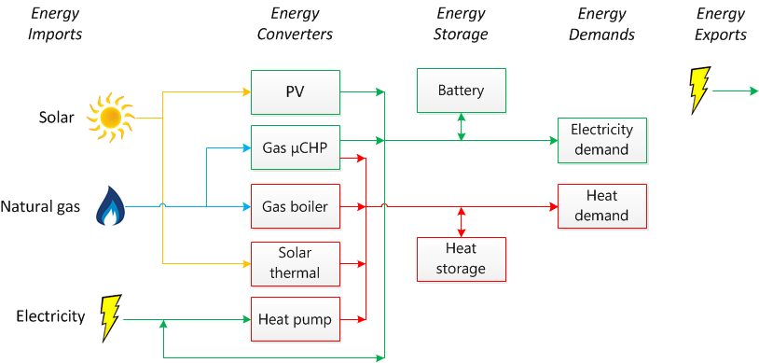
Single Hub Energy System Flow Diagram

Slide 12
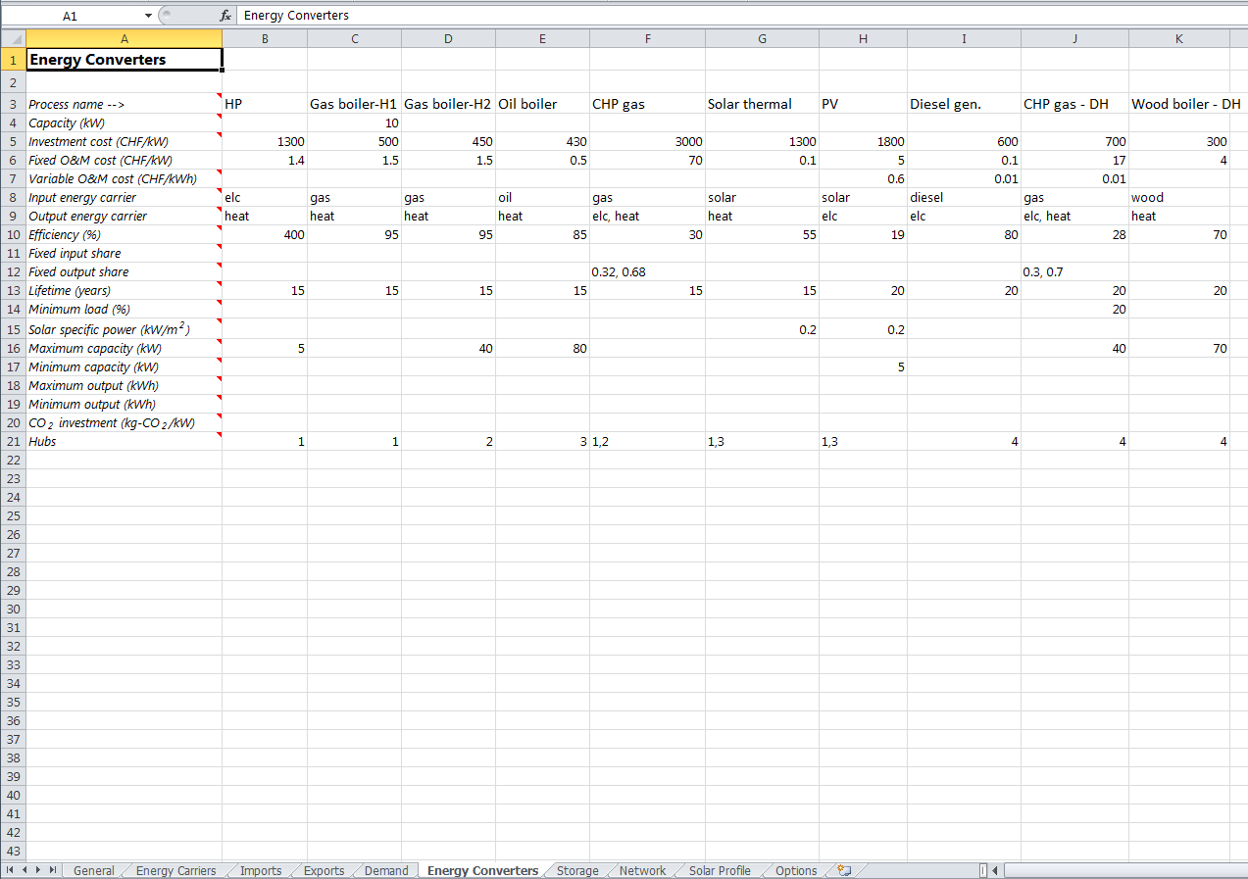
Model Input File

Slide 13
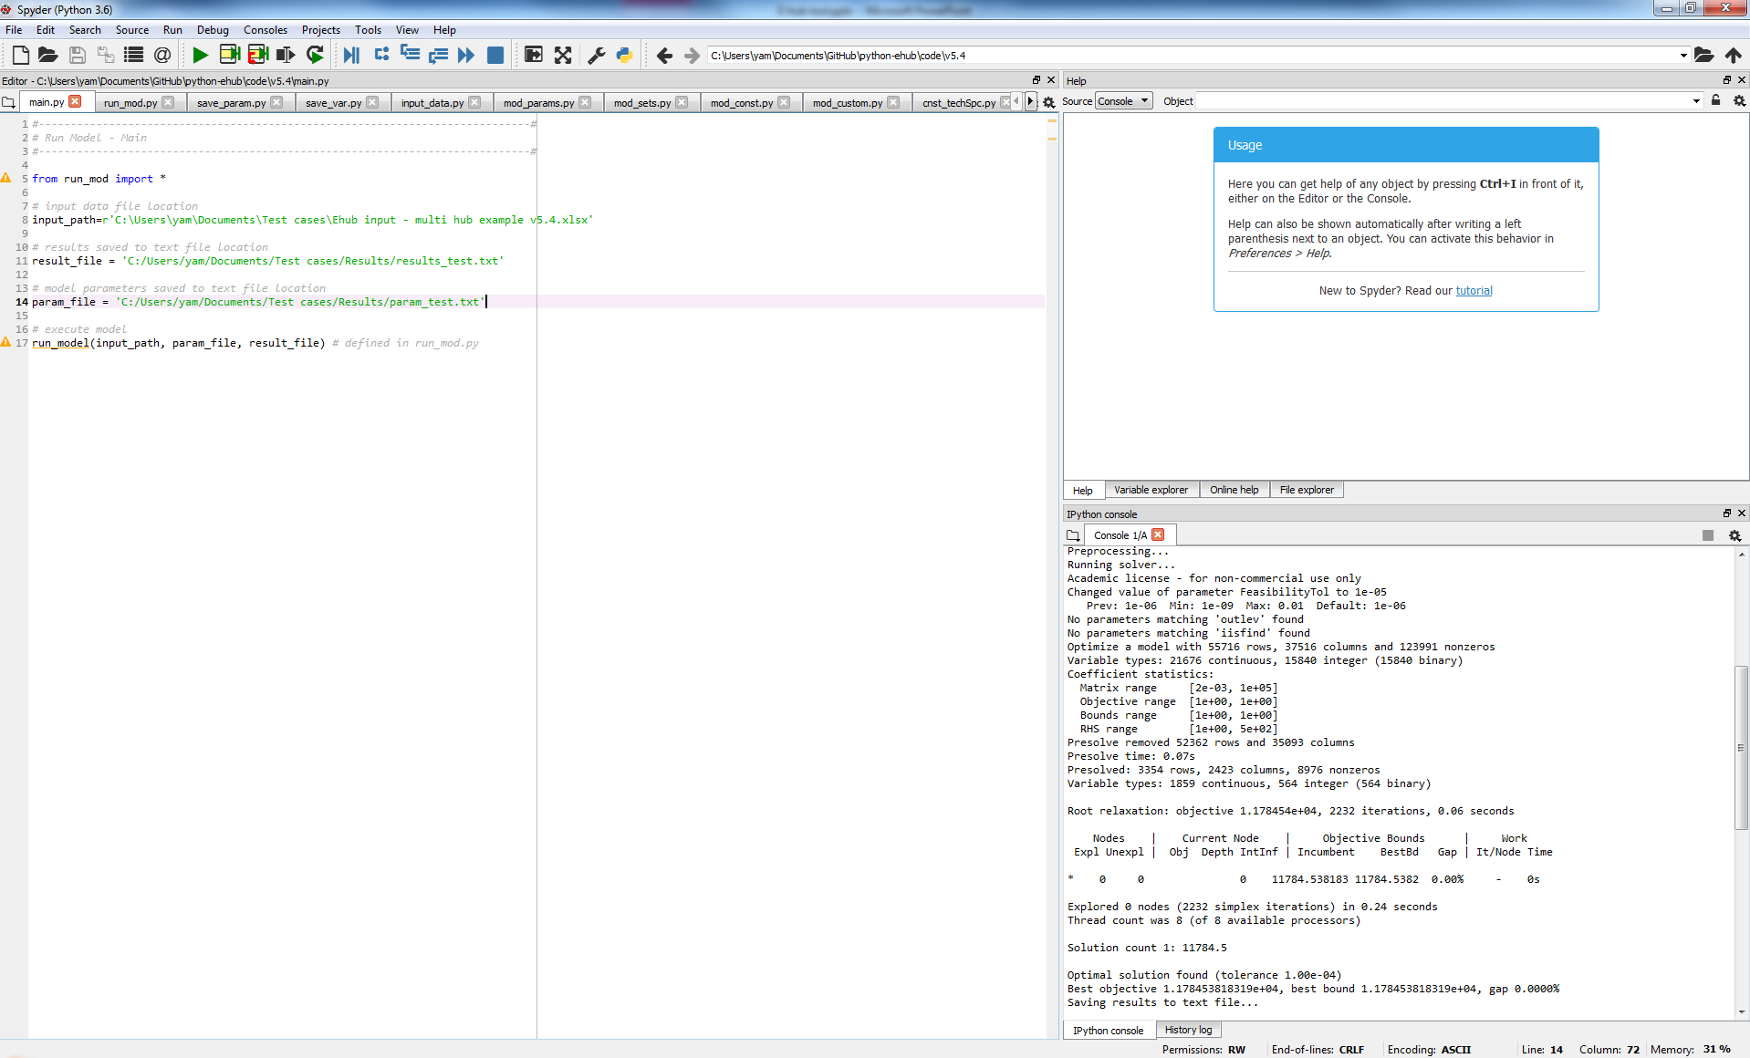
Running a Model

Slide 14
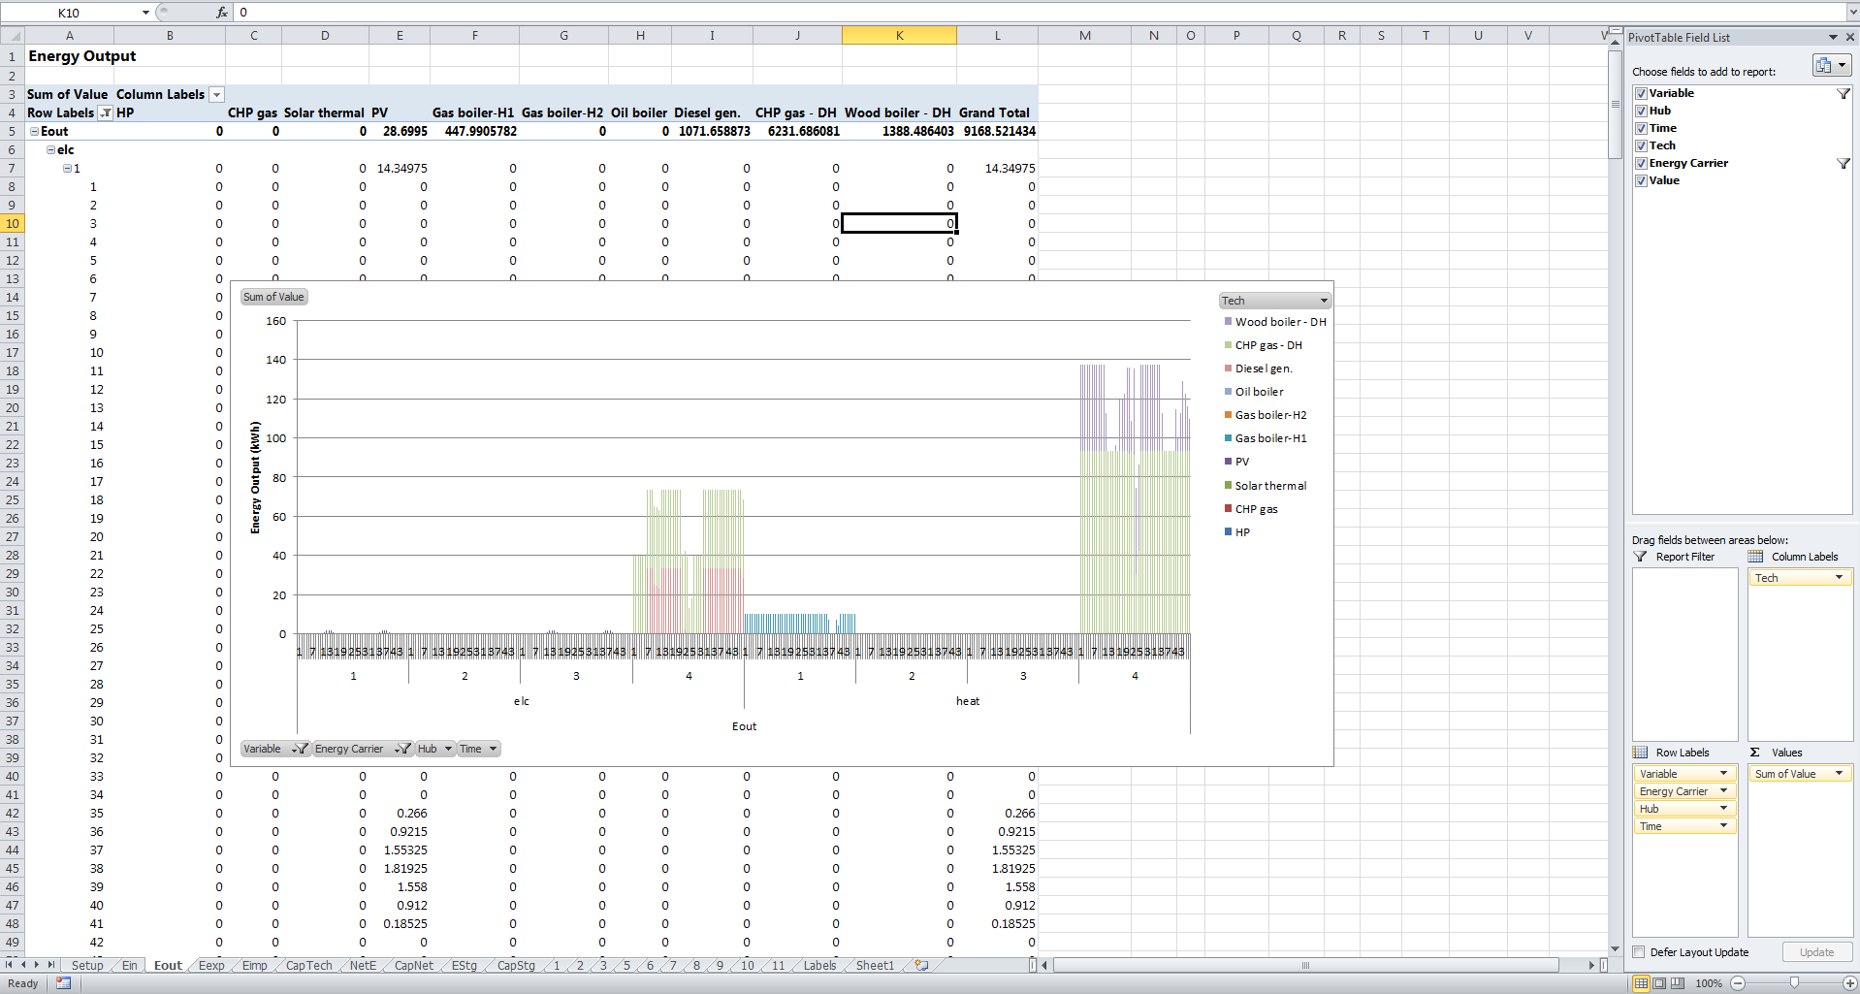
Navigating Results

Slide 15



Multi Hub
1
2
Imports
Exports
3

Slide 16

Multi Hub + Network
1
2
Imports
Exports
3

Slide 17



Multi Hub + Network + Centralized (Local) Generation
Imports
1
2
3
4
Exports
Generation hub

Slide 18
Multi Hub + Network + Centralized (Local) Generation → Microgrid Operation
Microgrid
Imports
1
2
3
4
Exports
Generation hub

Slide 19




Multi Hub - Communities
Imports/Exports

Slide 20





Multi Hub - Countries
Imports/Exports

Slide 21
Further Development
Adaptations providing modeling flexibility:
Flexible time period definitions (e.g., days, months, seasons, etc.)
Long-term (multi-year) planning
User interfacing (GUI, input error checking, etc.)
Model generation efficiency improvements
Integration with other models/research within UESL
…<insert your ideas>
Thank you!

